Slide 1
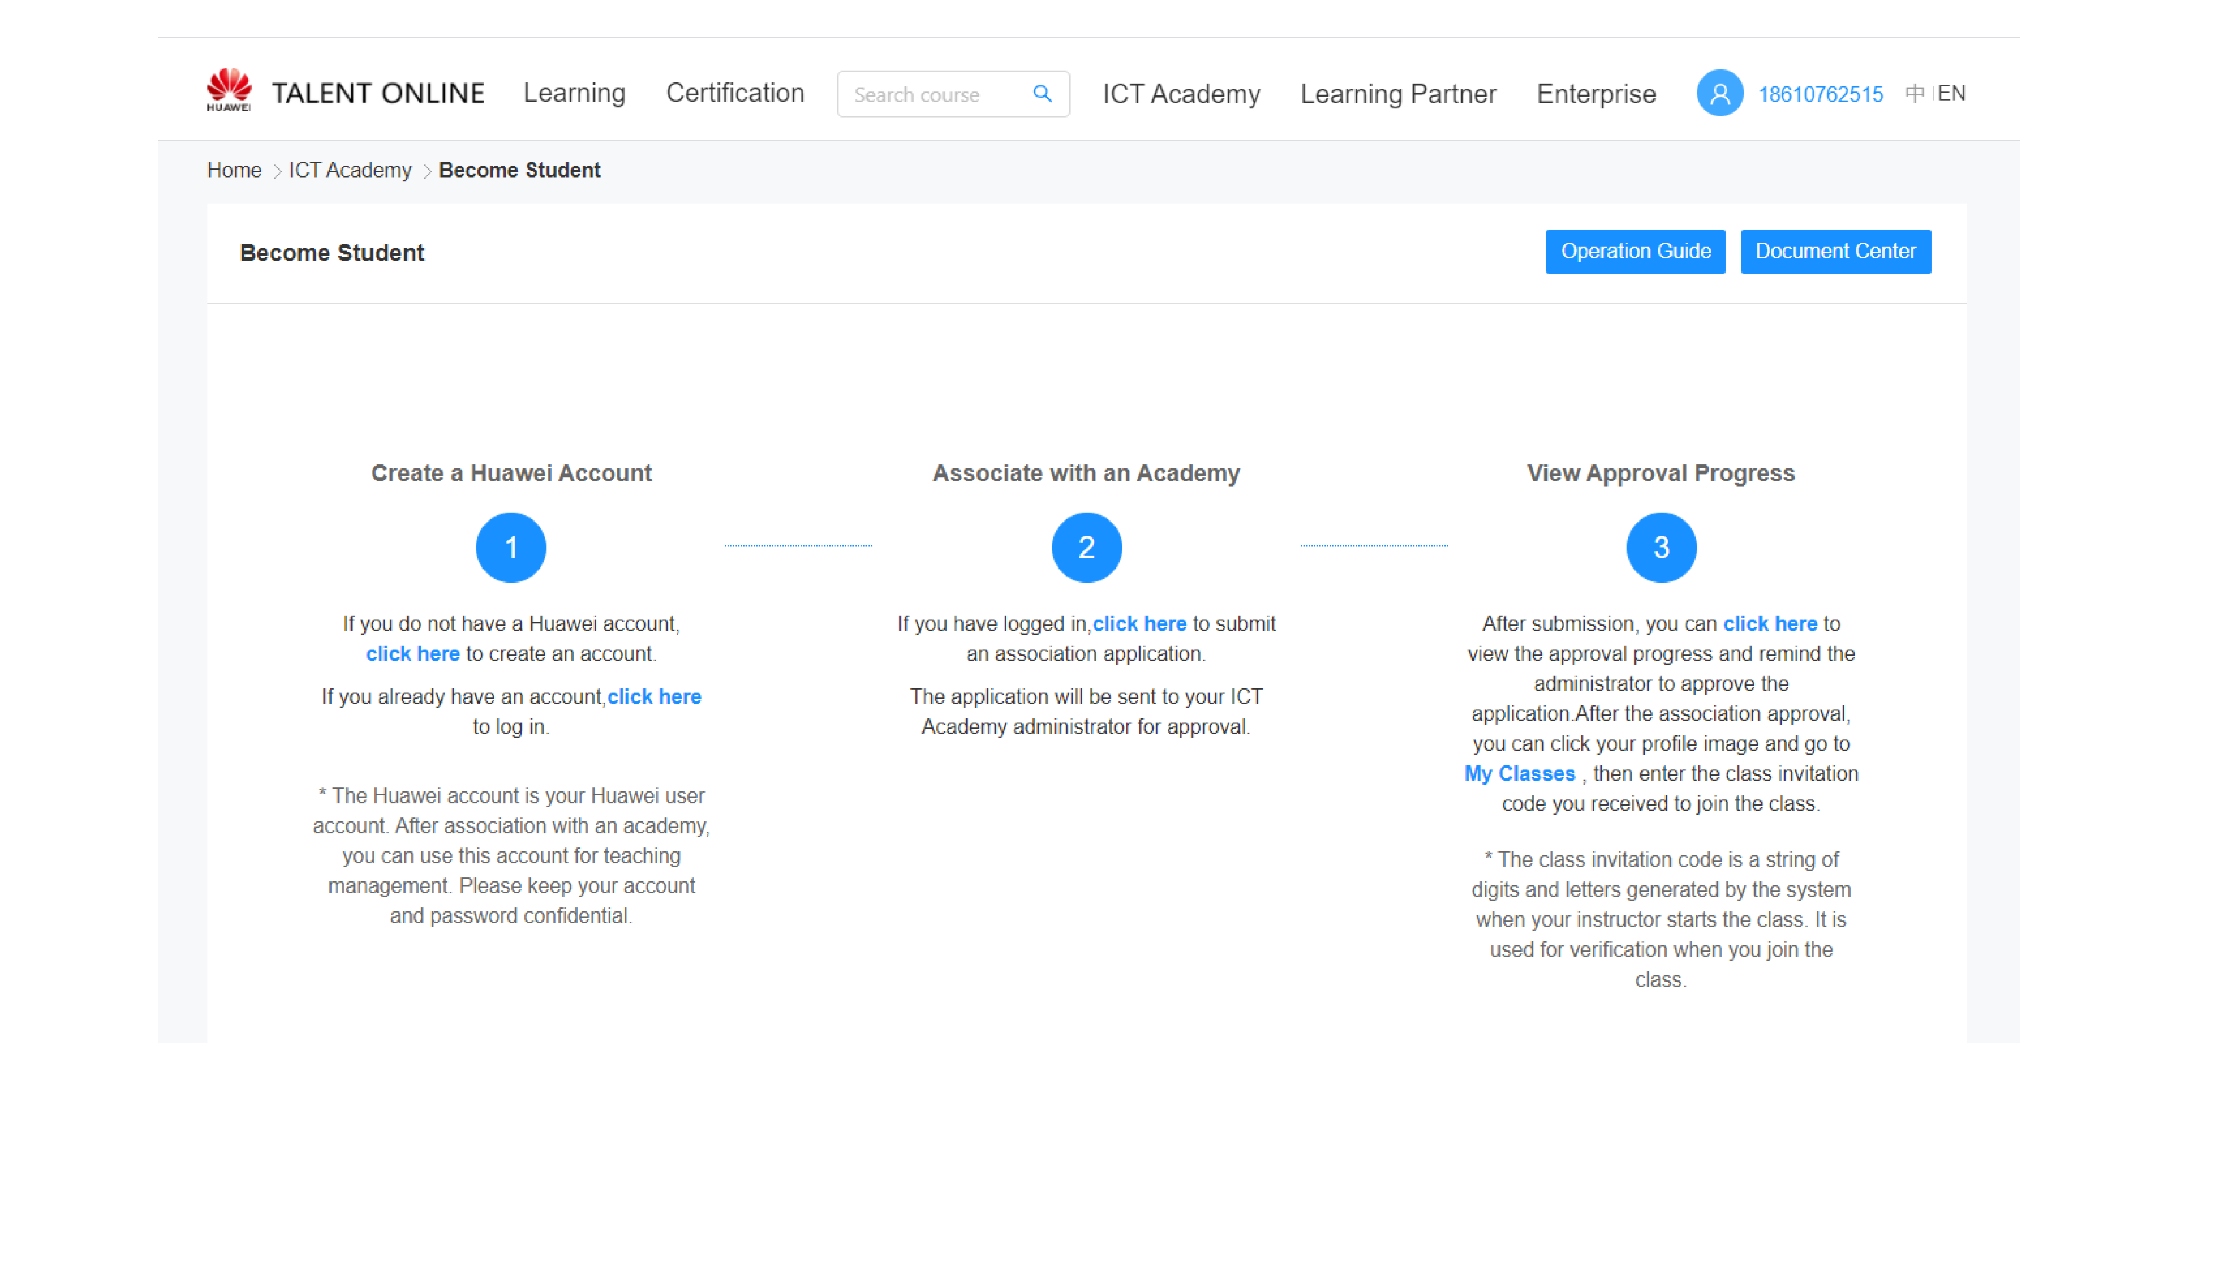
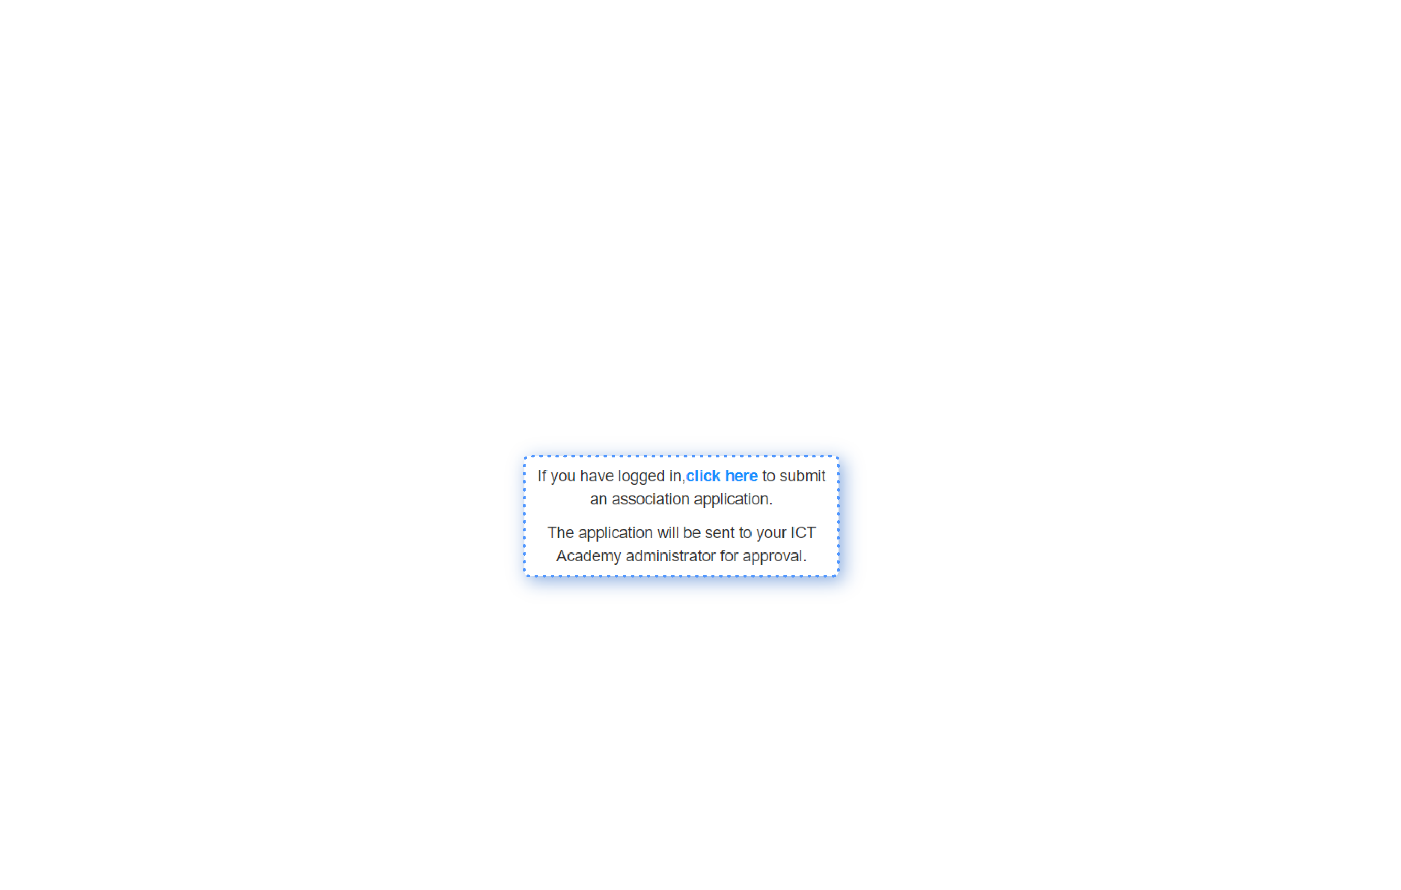
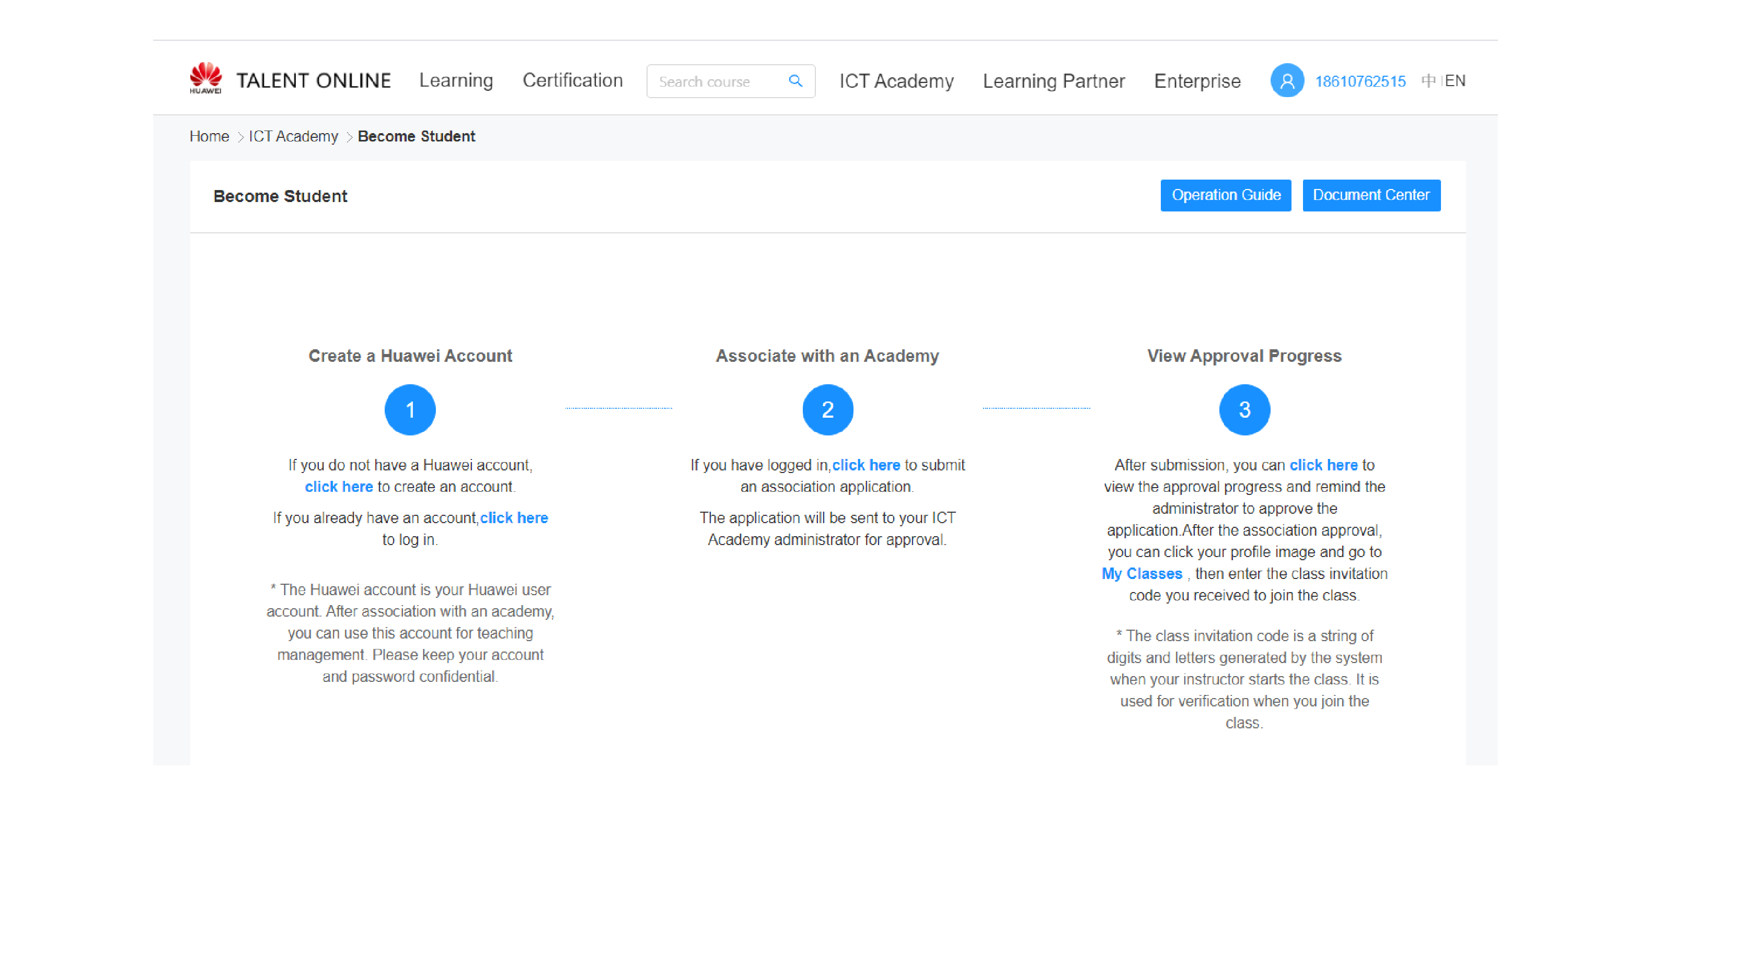
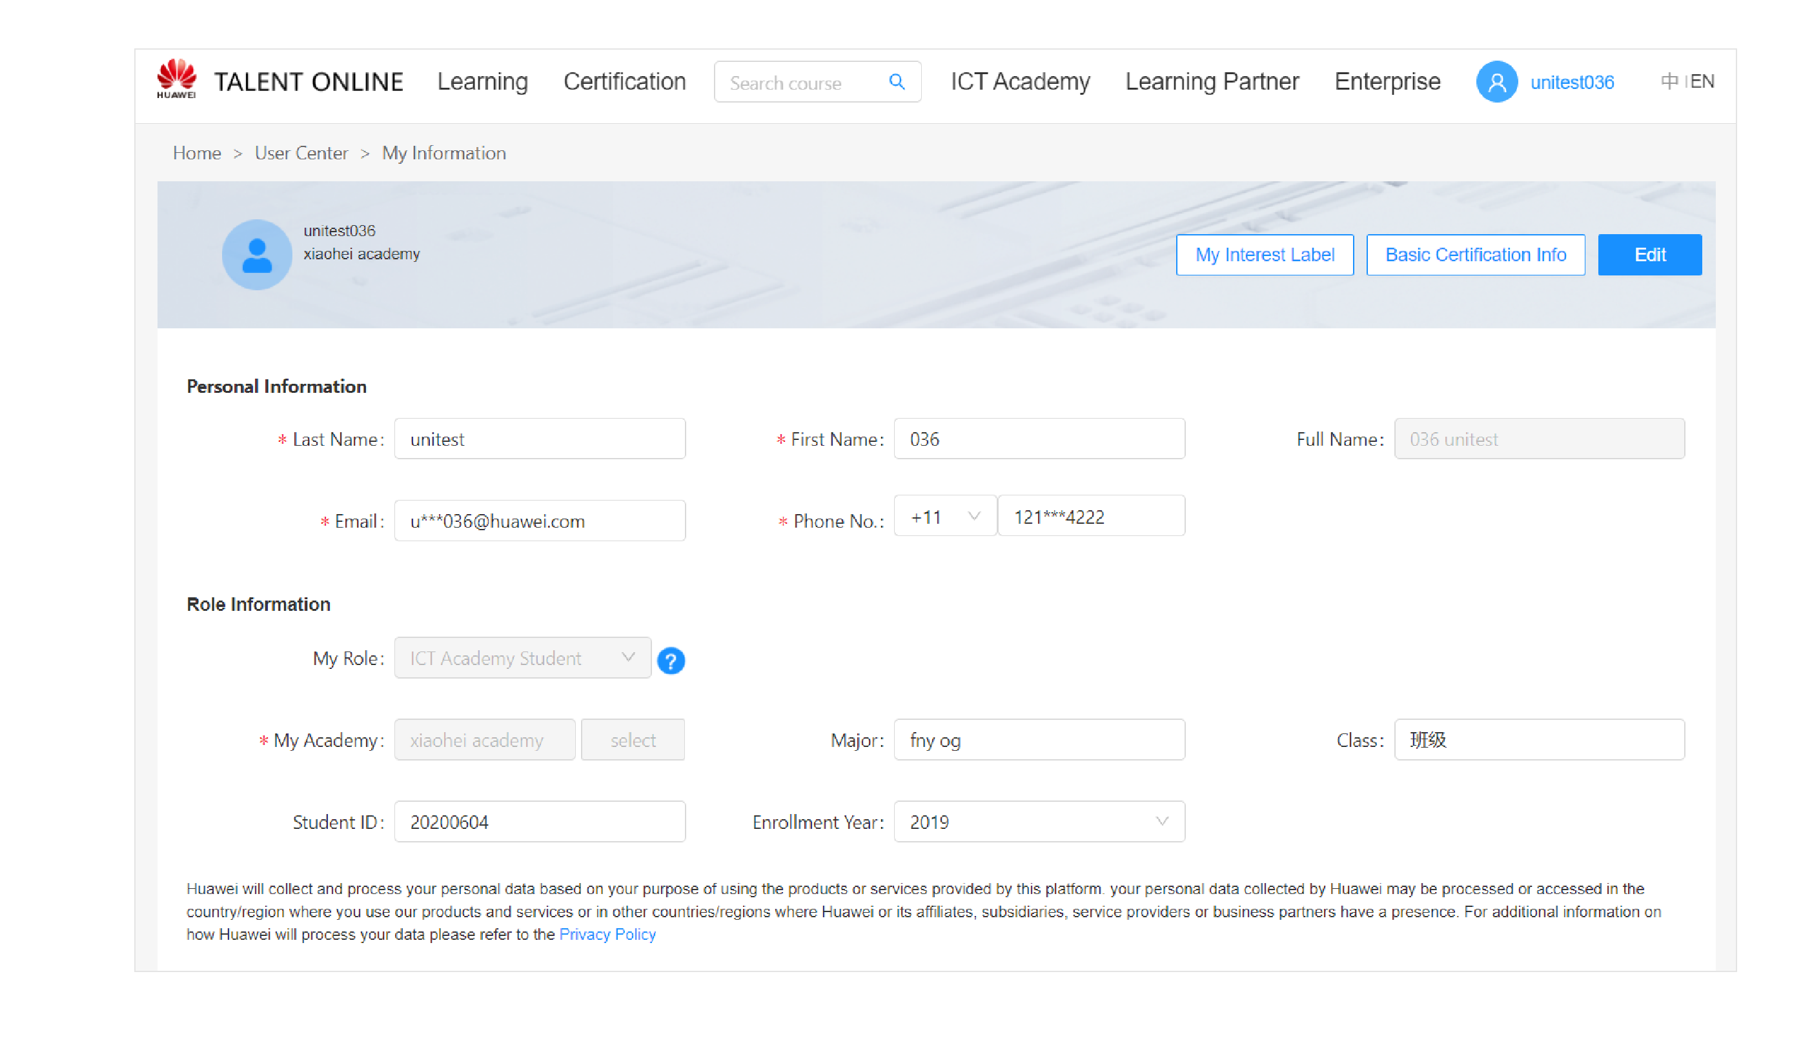
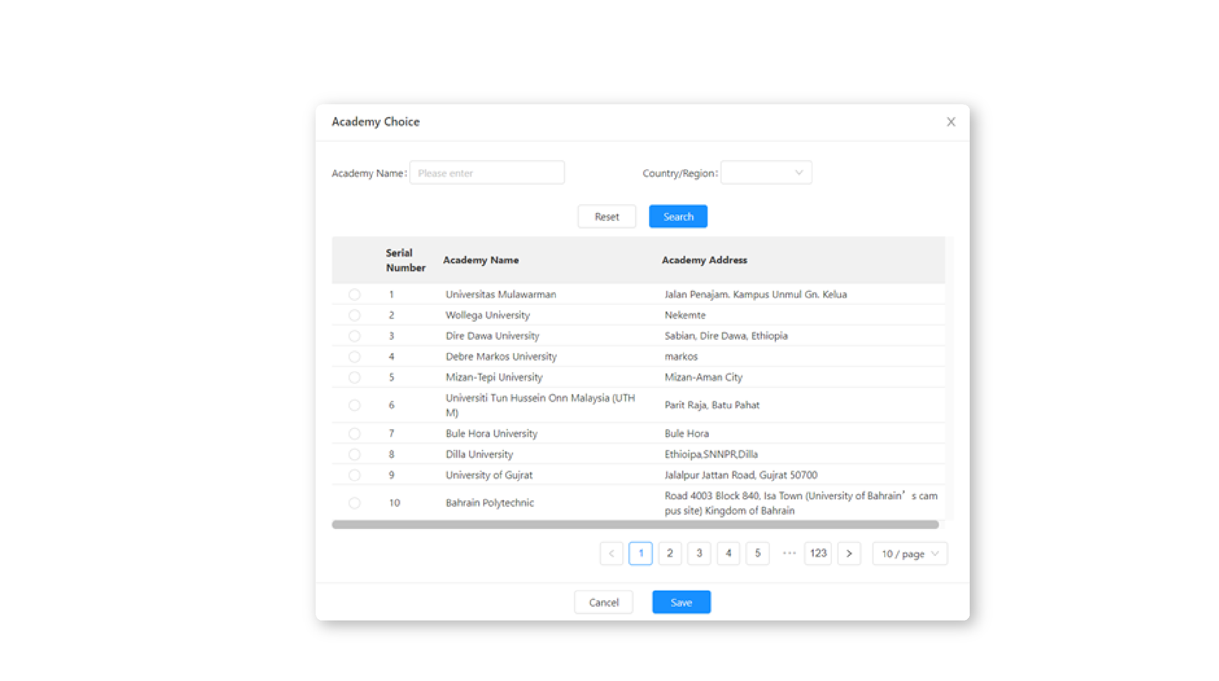
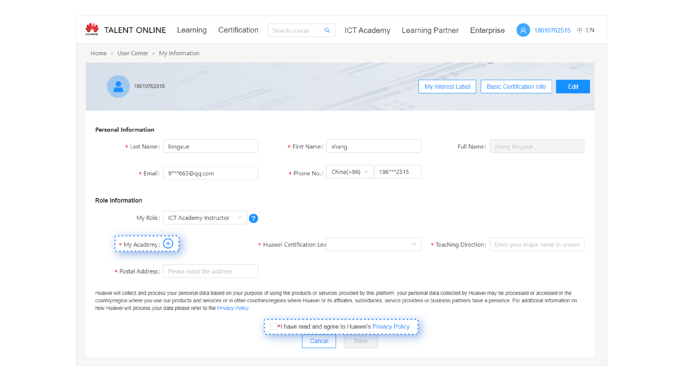
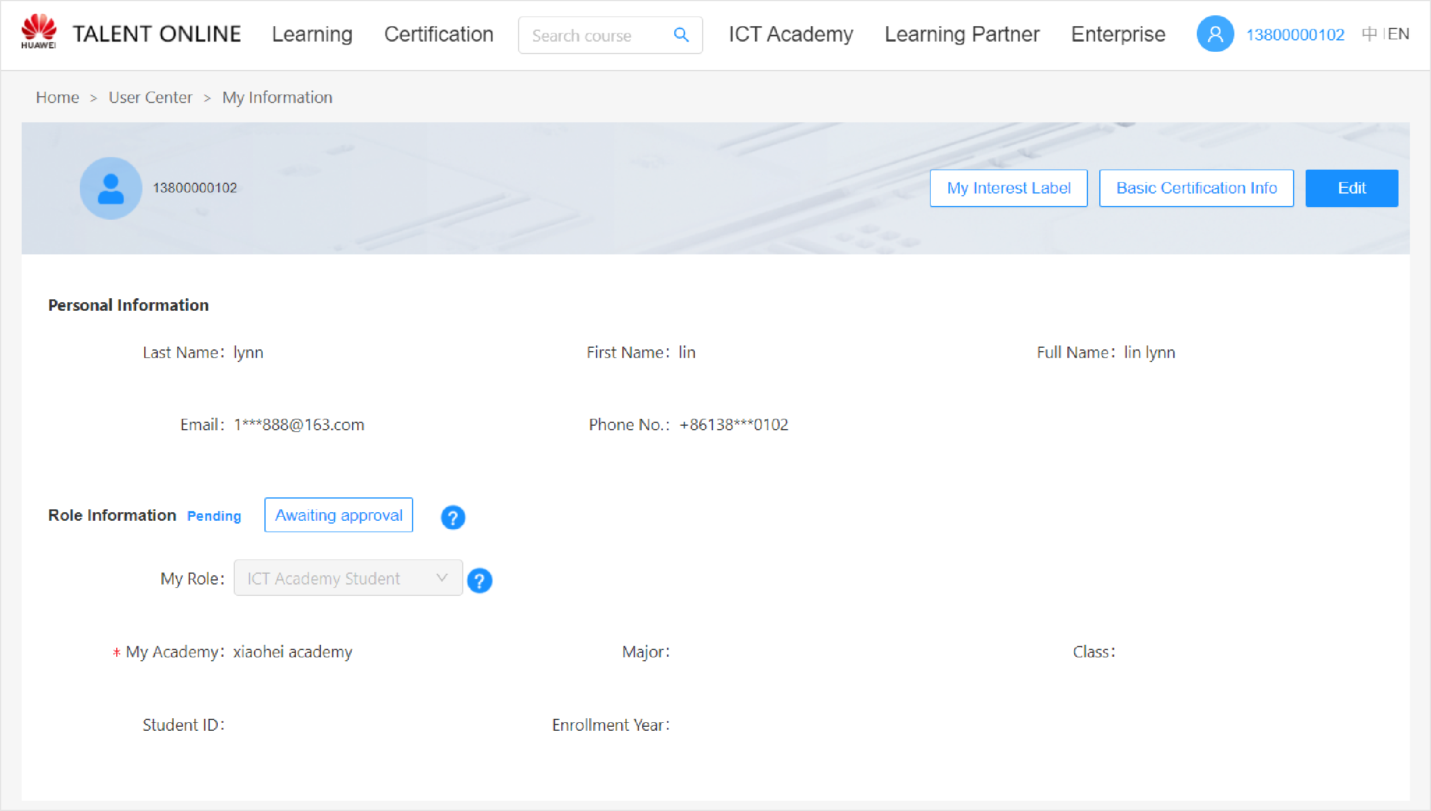
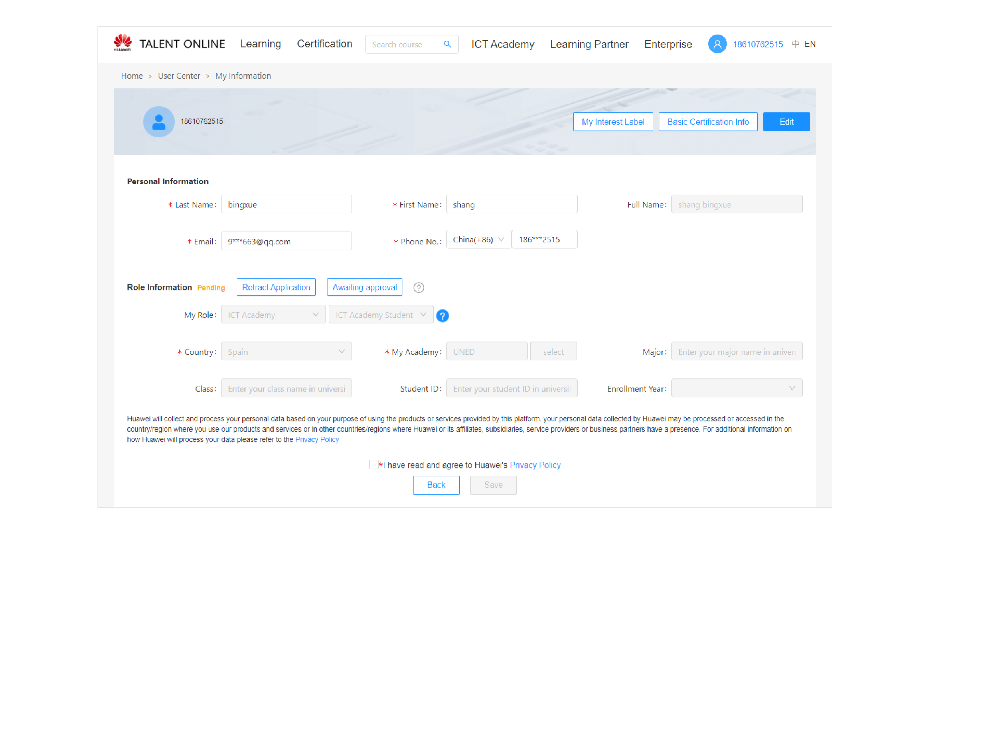
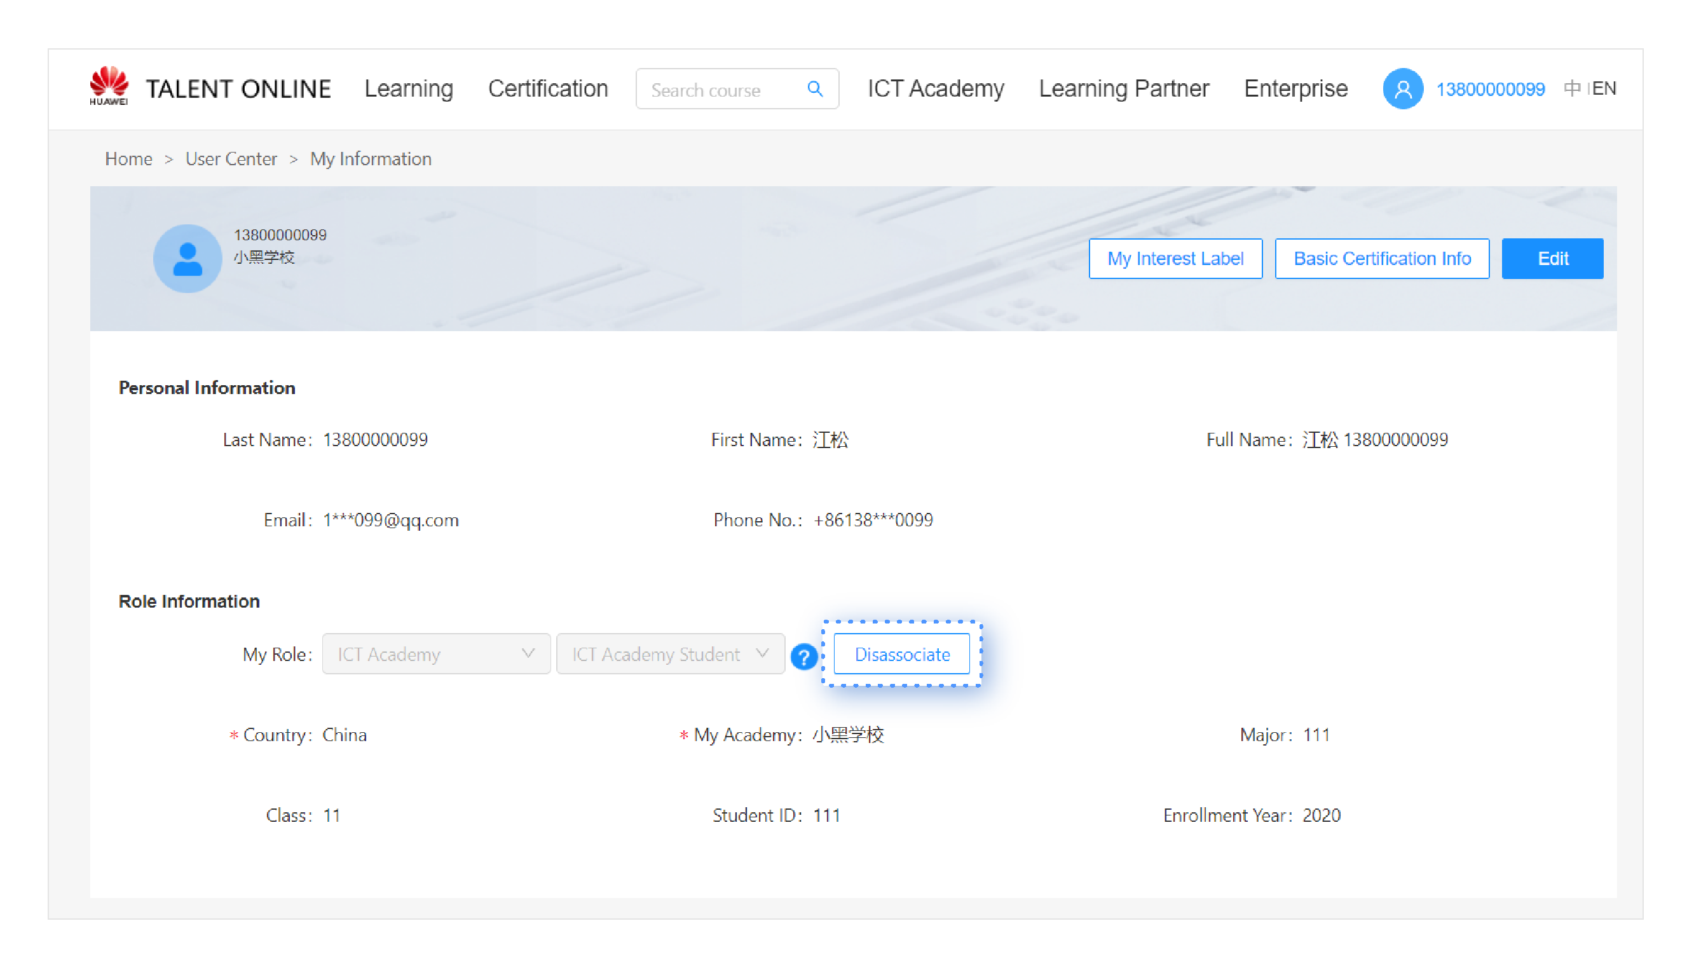
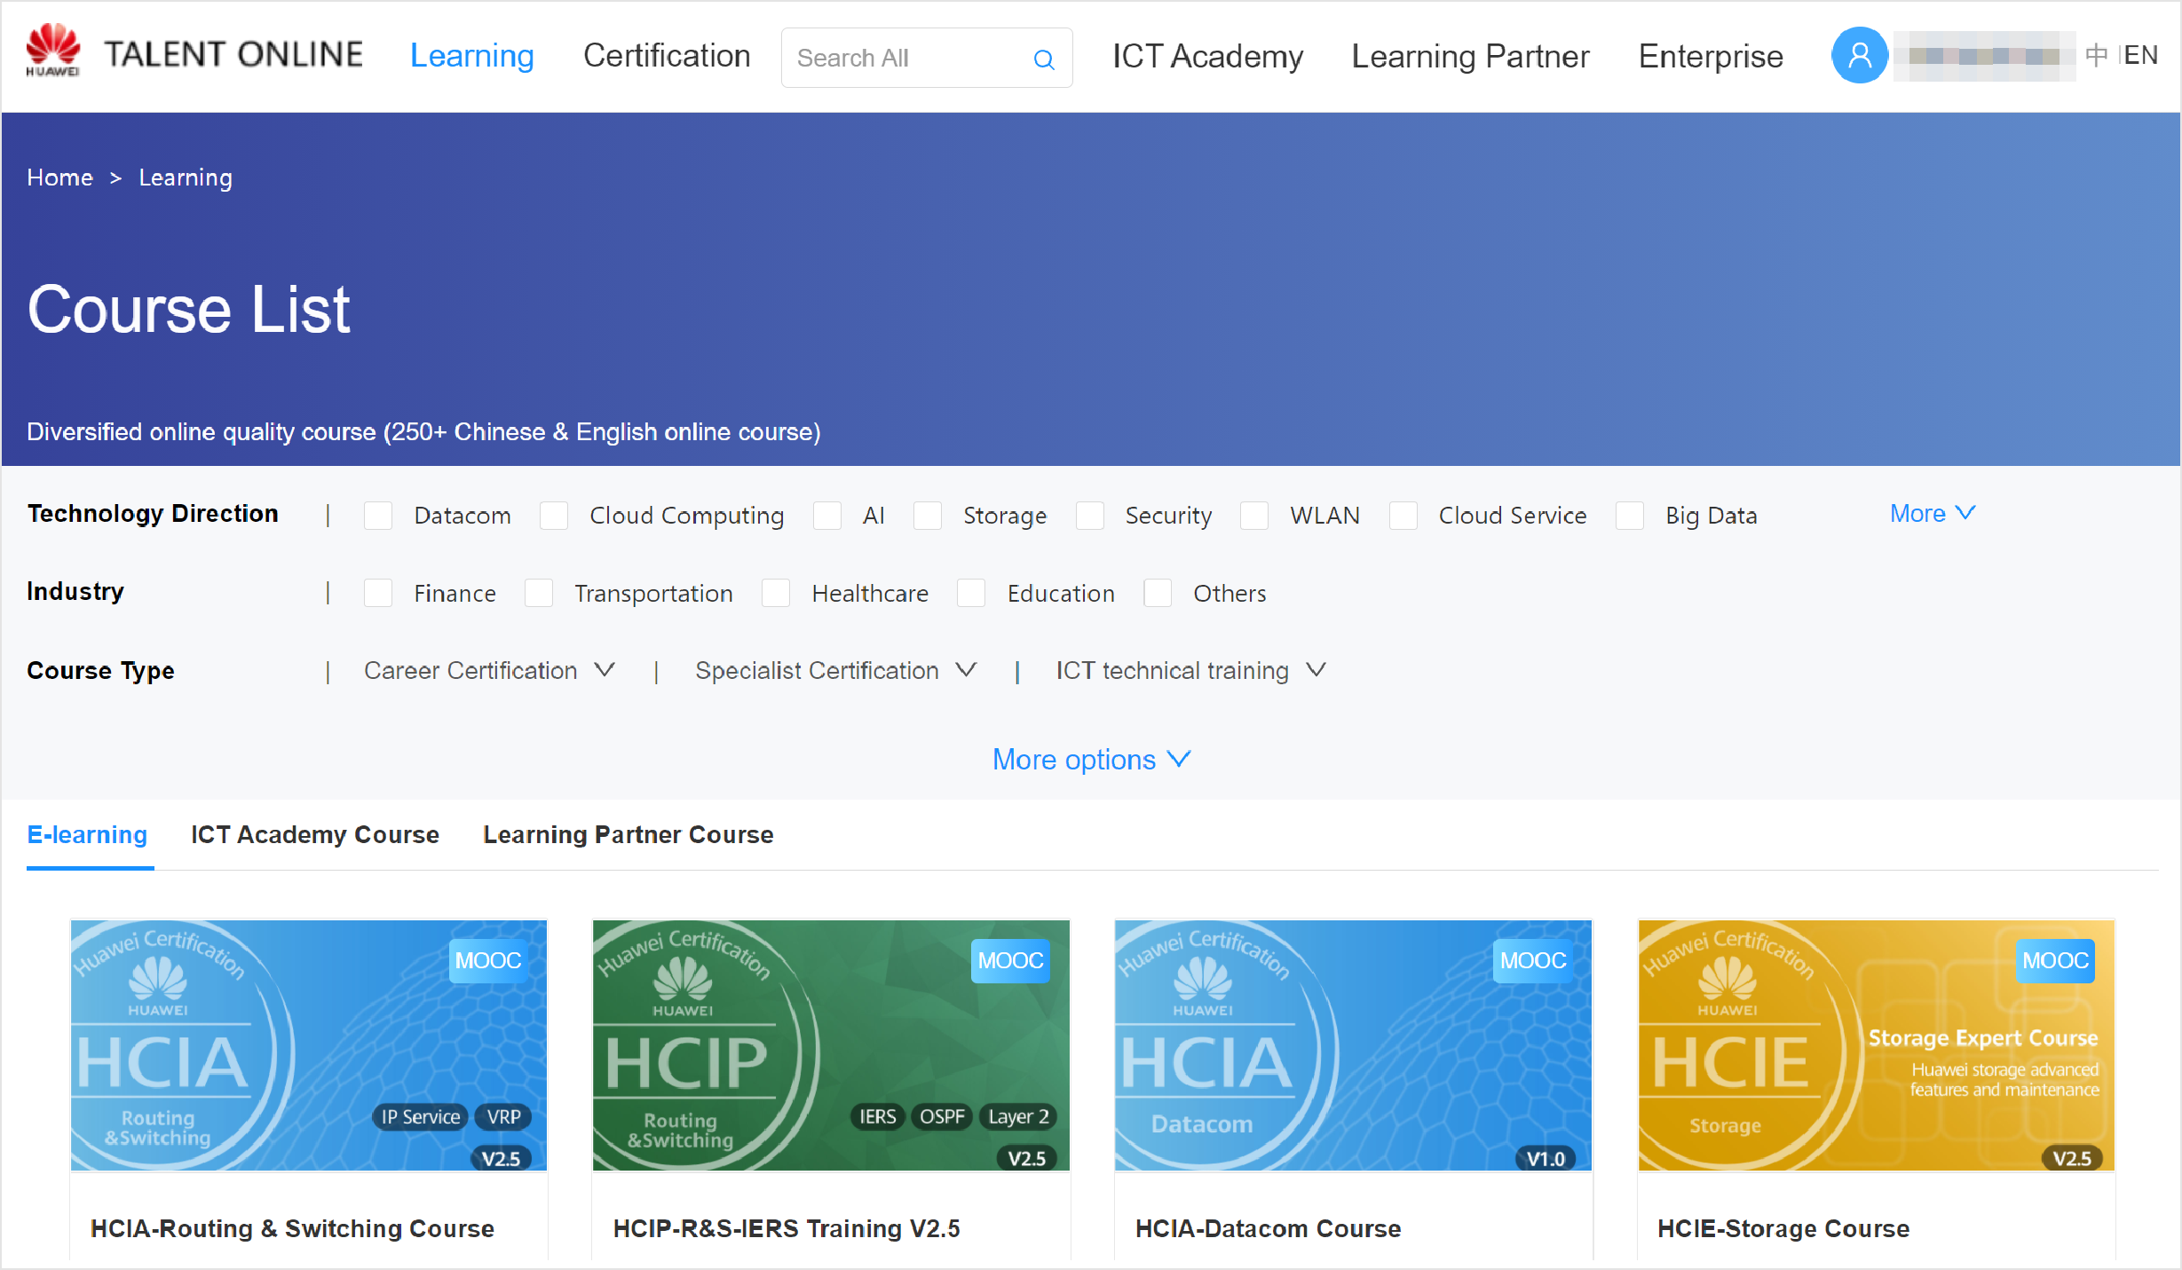
e
n
li
n
t
o
n
e
l
a
T
Register & Learn-Huawei ICT Academy Student Operation Guide
1ICT Academy Homepage
Click the link below：
https://e.huawei.com/cn/talent/#/ict-academy/home
Click or Copy
On the page of ICT Academy：
Click the button - BecomeICT Academy Student, then perform the following steps.
2 Become a Student
Perform steps 1 to 3. After submitting the association ap- plication, wait for the ICT academy admin to approve. You can view the approval progress through the quick entry.
Note: You need to register a Huawei account and login before performing subsequent operations.
3
Click the link on step 2 or click the avatar in the upper right corner to go to the Personal Information page.
Select ICT Academy Student.
①Click “+”
②In My Academy, select the university or college to be associated.
③Click Save.
If you have read and agreed to Huawei privacy statement, please save and submit the information. Then you need to wait for the ICT academy admin to approve your application.
During the review process, you can urge approval every 24 hours on the personal information page.
The association application has been submitted but has not been approved by the academy administrator. To retract the application or select another academy, please click the button to retract the application.
If you want to disassociate your role, please click the button Disassociate. After disassociating, you will lose all permissions of the role. If you want to associate with an ICT Academy again, log in again and click the association button to select
4
①Click here to enter into courses selection page.
②Click to select universal courses. associated.
③Click to select your ICT Academy’s courses.
Both of universal course and ICT
Academy course are available for you. Select any course, and join to learn.
After you join in a course, click here to join Quiz. Answer all questions, then submit.

